Slide 1

COS1512 – Online Class Session – 11 MAY 2026
COS1512 – INTRODUCTION TO PROGRAMMING II – Using C++
Academic Year: 2026
Date: 22 MAY 2026
Time: 17:00 PM to 19:00 PM

Slide 2
Topics
Chapter 4
Procedural Abstraction and Functions That Return Value

Slide 3
Contents
Top-Down Design
Predefined Functions
Programmer Defined Functions
Procedural Abstraction
Scope and Local Variables
Overloading Function Names

Slide 4
Top-Down Design
Algorithm – step by step way (set of instructions) of solving the problem.
Top-down design – design of the algorithm in a way of breaking down the task to be accomplished into a few subtasks, decompose each of these subtasks into smaller subtasks, and so forth. This method is also called called stepwise refinement or divide and conquer.
This design makes it:
easier to understand the program,
easier to change the program, if need be, and,
easier to write, test, debug, and maintain the program.

Slide 5
Top-Down Design
C++ has facilities to include separate subparts inside of a program. These subparts are called functions. Functions are also called subprograms, procedures, or methods.

Slide 6
Functions
What is a Function?
A function is a reusable block of code designed to perform a specific task. Think of it as a “method" that you write once and can use whenever you need it.
We have:
Predefined functions and,
Programmer defined functions.

Slide 7
Predefined Functions
Predefined functions – functions that are already defined for you to use. For example, sqrt, pow, exp, min, max, etc. C++ programmers already defined these predefined functions for us to use. They are defined inside the libraries or preprocessor directives.

Slide 8
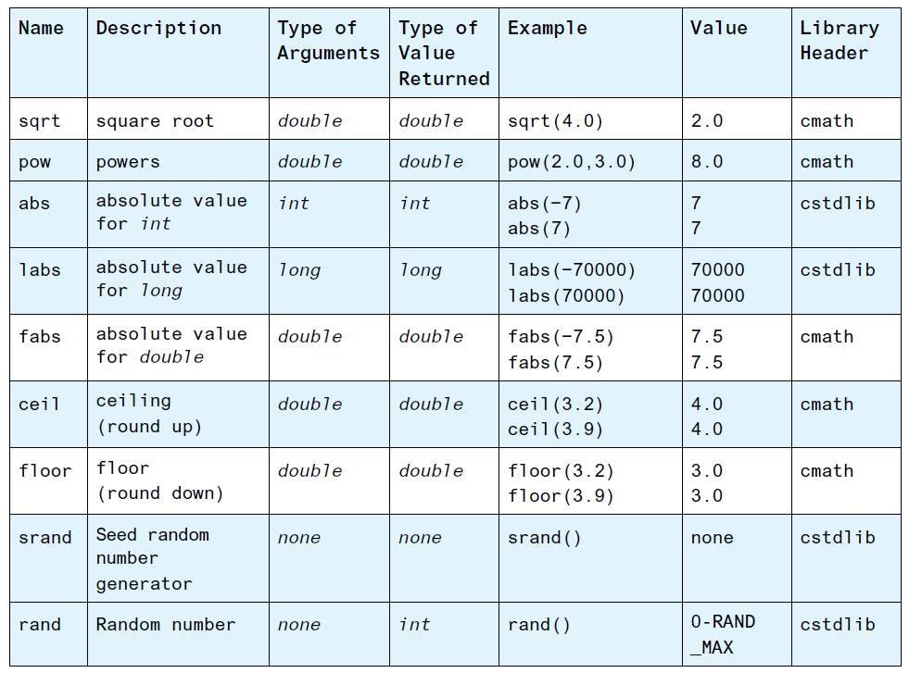
Predefined Functions
Examples of Predefined functions

Slide 9
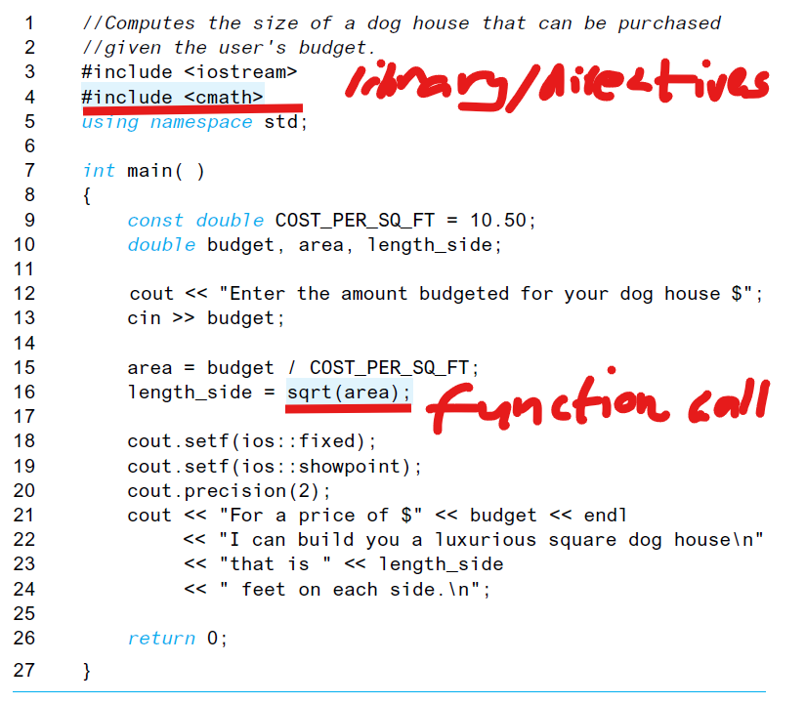
Using Predefined Functions
Example of Using Predefined functions
Libraries / preprocessor directives
Function call

Slide 10
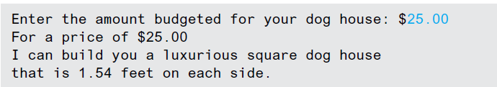
Using Predefined Functions
Using Predefined functions
Results of the previous code:
Another example of predefined function:
double result, x = 3.0, y = 2.0;
result = pow(x, y);
cout << result;

Slide 11
Using Predefined Functions
Using Predefined functions
Random Number Generation:
C++ has a predefined function to generate pseudorandom numbers.
pseudorandom number is one that appears to be random but is really determined by a predictable formula.
To seed C++’s random number generator use the predefined method srand. It returns no value and takes as input an unsigned integer that is the initial seed value. To always seed the random number generator with the value 35, we would use:
srand(35);

Slide 12
Using Predefined Functions
Using Predefined functions
Random Number Generation:
To vary the random number sequence every time the program is executed, we can seed the random number generator with the time of day. Invoking the predefined function time(0) returns the number of seconds that have elapsed since January 1, 1970 on most systems. The time function requires you to include the ctime library.
#include <cstdlib>
#include <ctime>
...
srand(time(0));
For example, to simulate rolling a six sided die we could use the following:
int die = (rand() % 6) + 1;

Slide 13
Type Casting
Type Casting
A way of changing from one data type value to another or a different data type.
For example, changing from an int value to double value.
static_cast<double>(9)

Slide 14
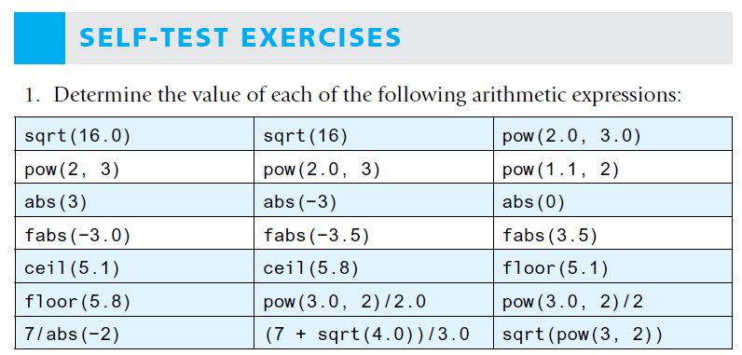
Exercises

Slide 15
Programmer Defined Functions
Programmer defined functions - functions that were written by somebody else. For example, CalcAverage(), Addition(), Subtraction(), DaysOfMonth(), etc. The programmer should define these functions. They are also referred to as user defined functions.
You can define your own functions, either in the same file as the main part of your program or in a separate file so that the functions can be used by several different programs.

Slide 16
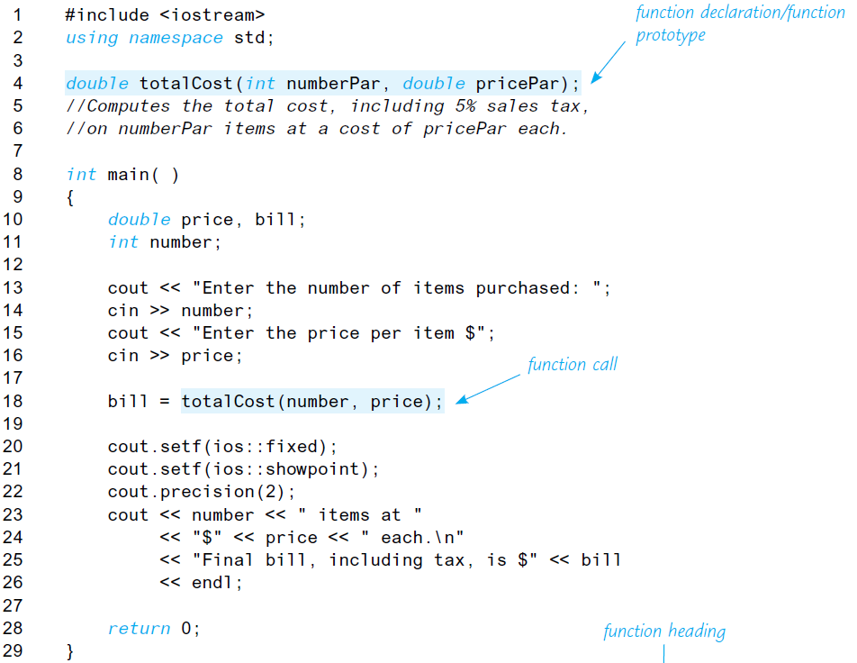
Programmer Defined Functions
Example of Programmer defined functions

Slide 17
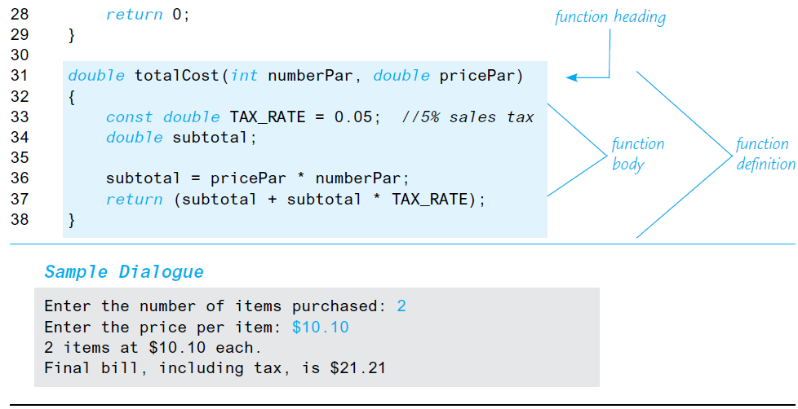
Programmer Defined Functions
Example of Programmer defined functions

Slide 18
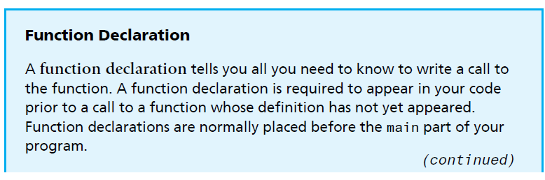
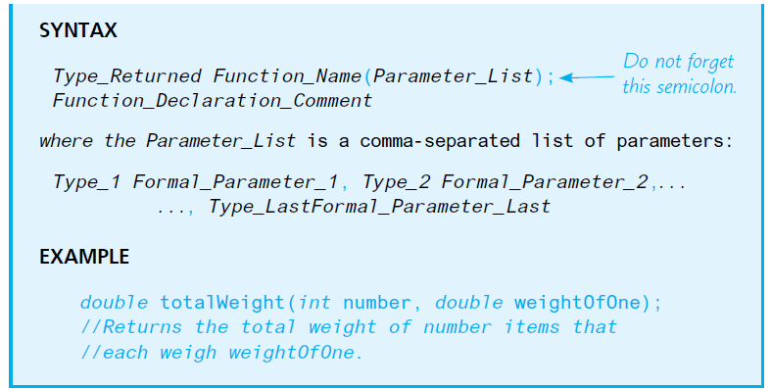
Programmer Defined Functions
Programmer defined functions – Function Declaration

Slide 19
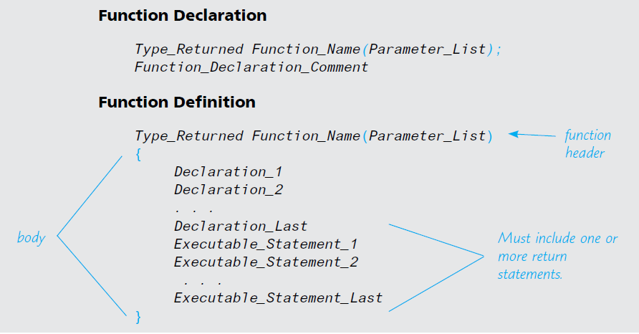
Programmer Defined Functions
Programmer defined functions – Function Declaration and Definition

Slide 20
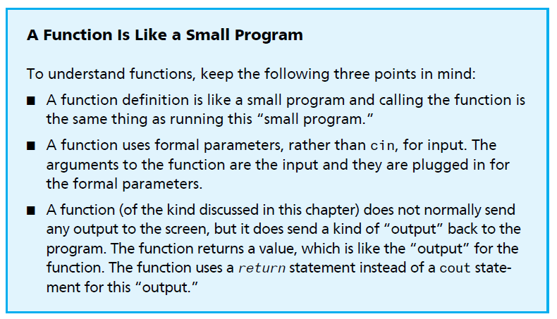
Programmer Defined Functions
Understanding Programmer defined functions

Slide 21
Programmer Defined Functions
Programmer defined functions – Example:
// determine the largest number from a
// between two numbers
// Function prototype
double larger(double x, double y);
// determine the largest number from a
// between two numbers
// Function prototype
double compareThree(double x, double y, double z);
// Function implementation
double larger(double x, double y)
{
if (x >= y)
return x;
else
return y;
}
// Function implementation
double compareThree(double x, double y, double z)
{
// Call function larger inside
// function compareThree to perform
// the comparison between y and z
return larger(x, larger(y, z));
}

Slide 22
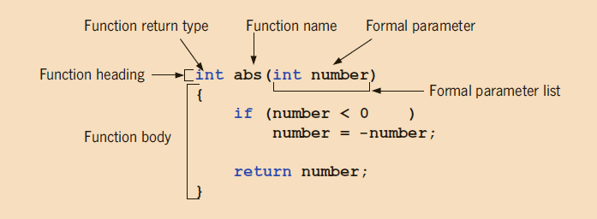
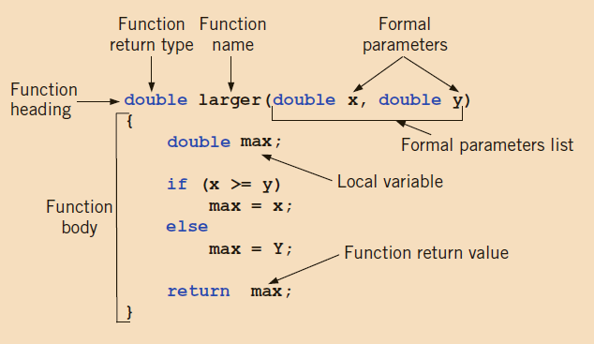
Programmer Defined Functions
Programmer defined functions –Various parts of the function abs
Various parts of the function larger

Slide 23
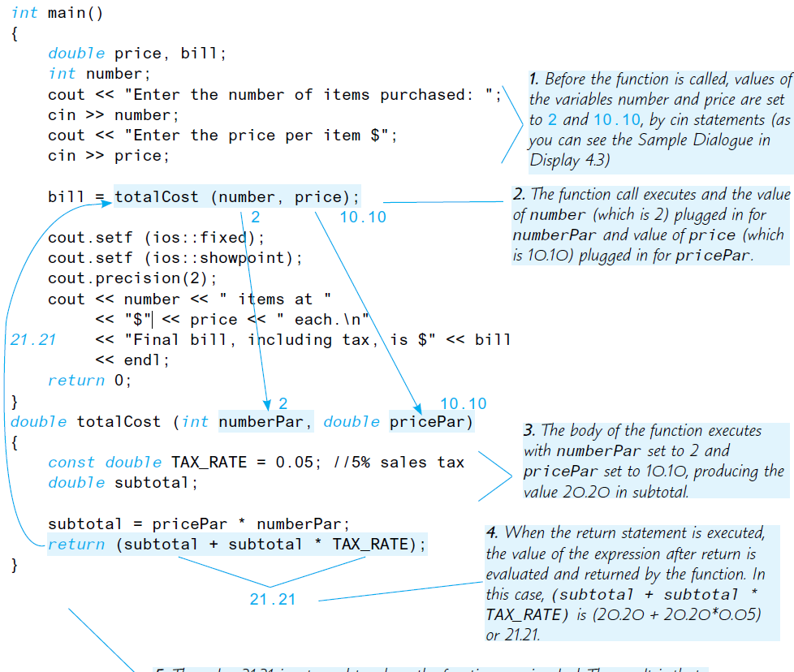
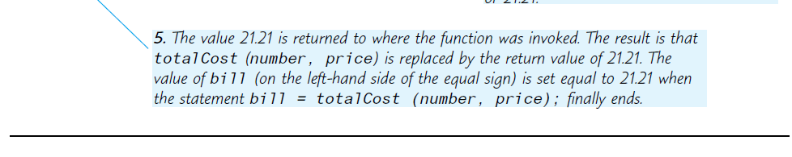
Programmer Defined Functions
Example of Programmer defined functions

Slide 24
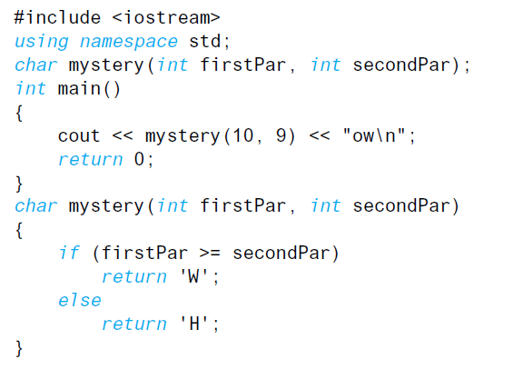
Exercises
1. Write a function declaration and a function definition for a function that takes three arguments, all of type int, and that returns the sum of its three arguments.
2. Write a function definition for a function called even that takes one argument of type int and returns a bool value. The function returns true if its one argument is an even number; otherwise, it returns false.
3. What is the output produced by the following program?

Slide 25
Procedural Abstraction
The Black-Box Analogy
A programmer who uses a function in a program needs to know what the function does (such as calculate the sum of 3 numbers) but should not need to know how the function accomplishes its task. This is often referred to as treating the function like a black box.
Designing a function so that it can be used as a black box is sometimes called information hiding to emphasize that the programmer acts as if the body of the function were hidden from view.
Writing and using functions as if they were black boxes is also called procedural abstraction (or a functional abstraction).

Slide 26
Procedural Abstraction
The Black-Box Analogy
Writing and using functions as if they were black boxes is also called procedural abstraction (or functional abstraction). The term abstraction is intended to convey the idea that when you use a function as a black box, you are abstracting away (ignoring or omitting specific) the details of the code contained in the function body. You can call this technique the black-box principle or the principle of procedural abstraction or information hiding. The three terms mean the same thing.

Slide 27
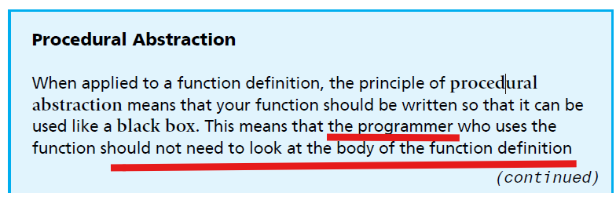
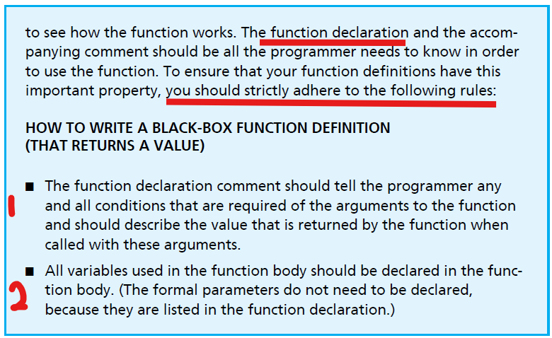
Procedural Abstraction

Slide 28
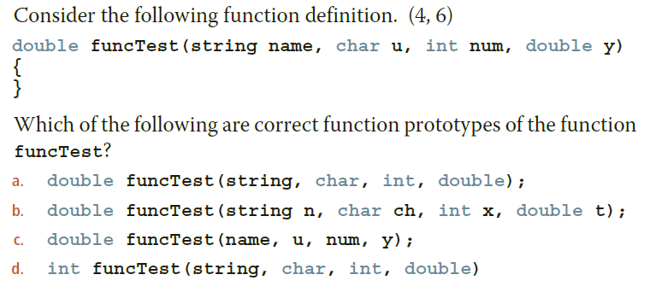
Procedural Abstraction
Exercise

Slide 29
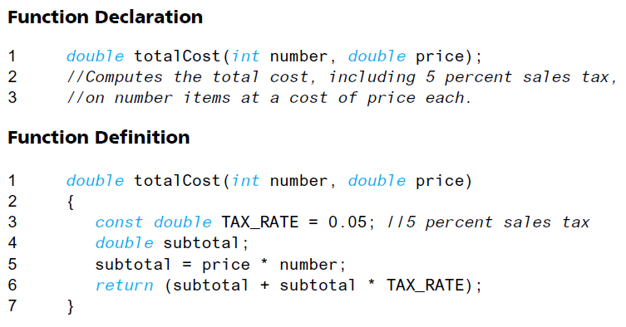
Procedural Abstraction
Simpler Formal Parameter Names

Slide 30
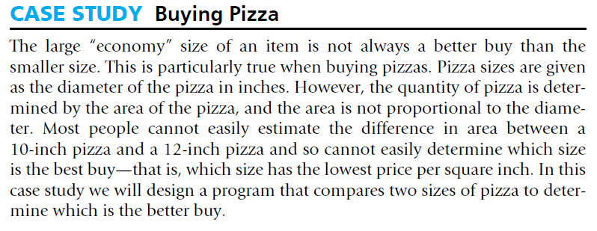
Case Study
Case Study pg. 243

Slide 31
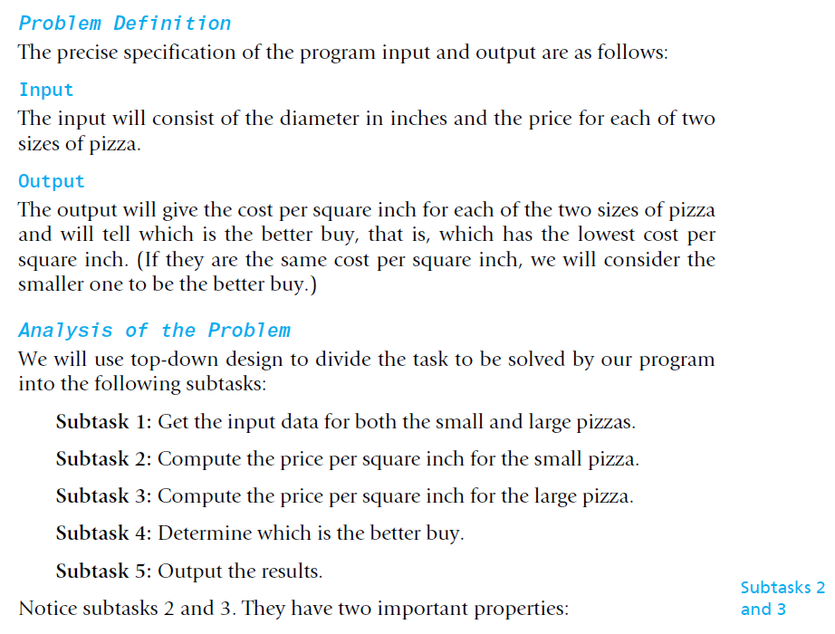
Case Study
Case Study pg. 243

Slide 32
Scope and Local Variables
Variables that are declared within the body of a function definition are said to be local to that function or to have that function as their scope.
Variables that are defined within the main body of the program are said to be local to the main part of the program or to have the main part of the program as their scope.
When we say that a variable is a local variable without any mention of a function and without any mention of the main part of the program, we mean that the variable is local to some function definition.

Slide 33
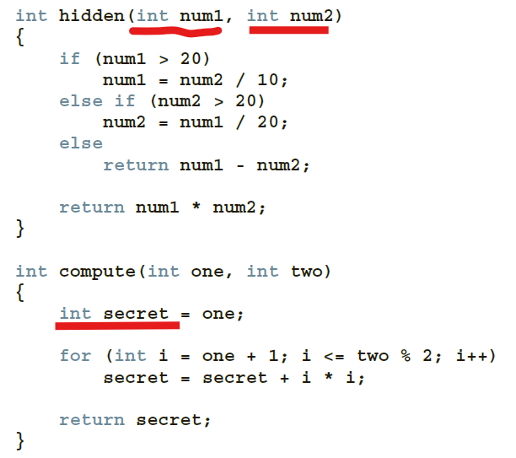
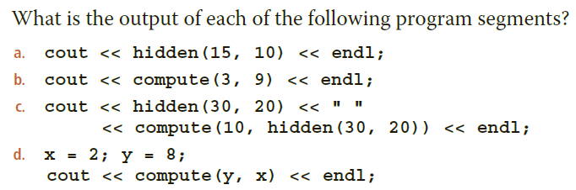
Example: Scope and Local Variables

Slide 34
Global Constants and Global Variables pg. 253
NB. You can place these declarations for naming constants inside the body of the functions. This works out fine because each named constant will be used by only one function.
NB. However, it can easily happen that more than one function uses a named constant. In that case you can place the declaration for naming a constant at the beginning of your program, outside of the body of all the functions and outside the body of the main part of your program. The named constant is then said to be a global named constant, and the named constant can be used in any function definition that follows the constant declaration.

Slide 35
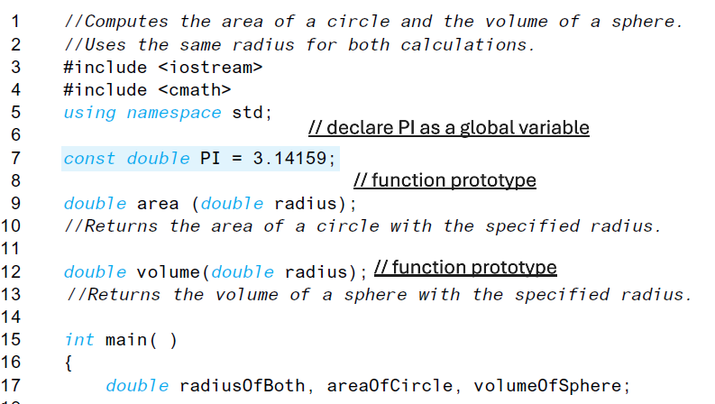
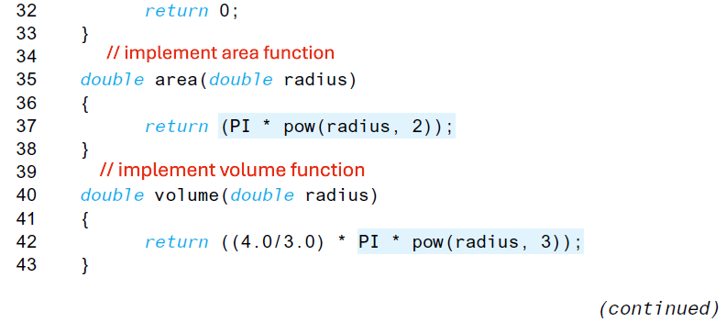
Global Constants and Global Variables pg.255

Slide 36
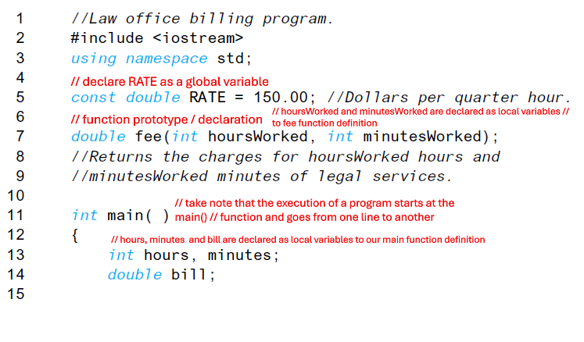
Call-by-Value Formal Parameters Are Local Variables
Formal parameters are actually variables that are local to the function definition, so they can be used just like a local variable that is declared in the function definition.

Slide 37
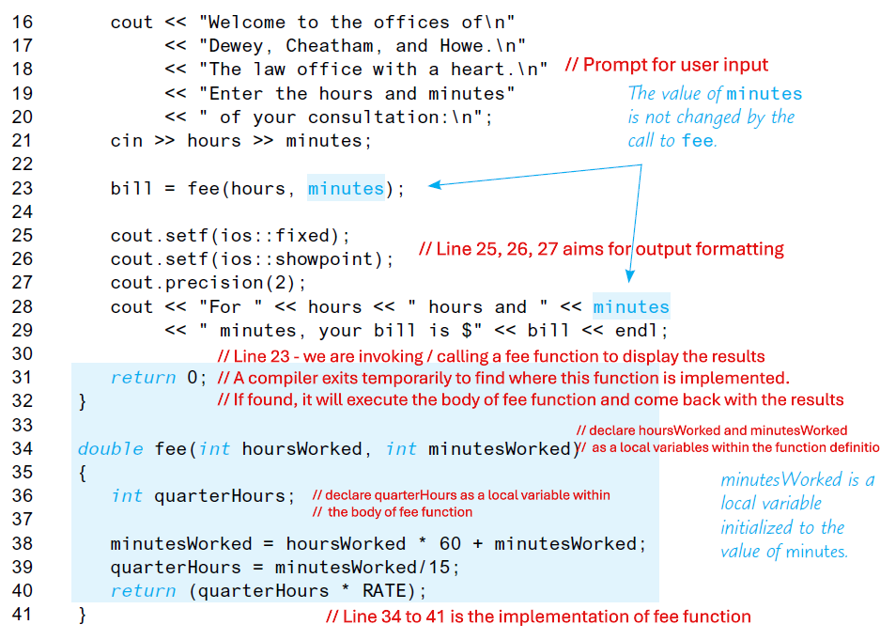
Call-by-Value Formal Parameters Are Local Variables

Slide 38
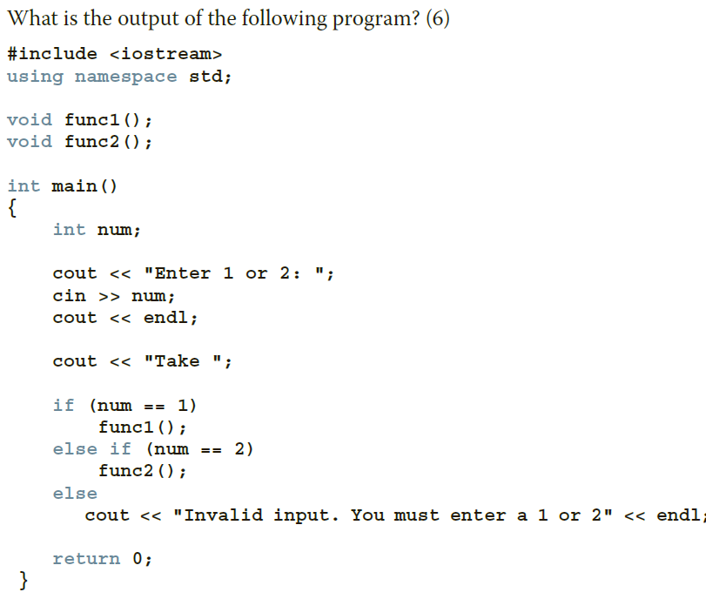
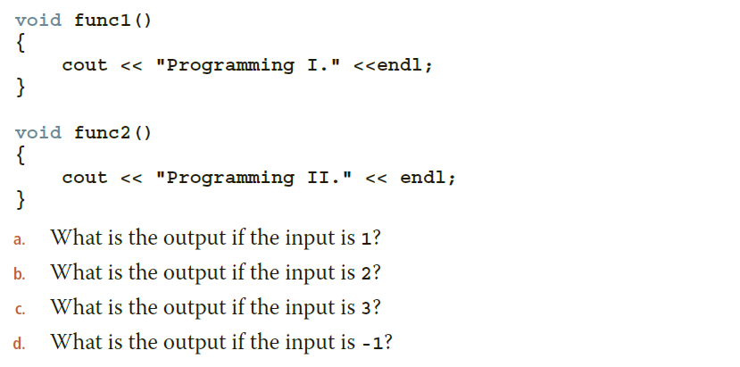
Example: Call-by-Value Formal Parameters Are Local Variables

Slide 39
Block Scope
The scope of a local variable refers to the part of a program that can directly access that variable and is sometimes referred to as local scope. Similarly, global identifiers declared at the beginning of your program, outside of the body of all the functions, are sometimes referred to as having global scope. Despite their differences, local and global identifiers are really examples of block scope.
Block scope is defined by using the opening and closing curly brackets { }.

Slide 40
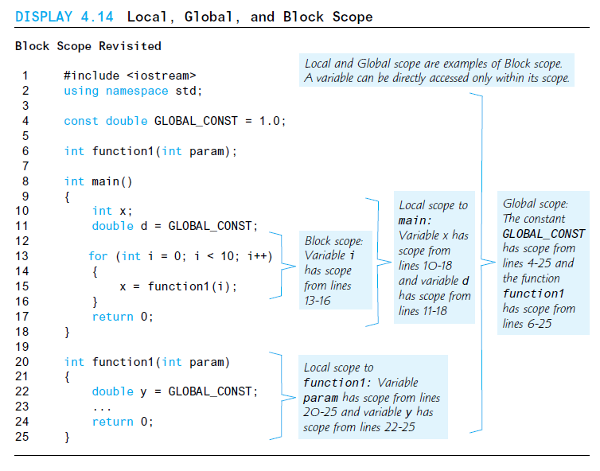
Block Scope
Example of Block, Local and Global Scope:

Slide 41
Overloading Functions
Function overloading a way of creating several functions with the same name.
If a function’s name is overloaded, then all of the functions in the set have the same name. Therefore, all the functions in the overloaded set must have different formal parameter lists.
Two functions are said to have different formal parameter lists if both functions have
A different number of formal parameters or
The same number of formal parameters and the data types of the formal parameters, in the order listed, differ in at least one position.

Slide 42
Overloading Functions
For example, consider the following function headings:
void functionOne(int x)
void functionTwo(int x, double y)
void functionThree(double y, int x)
int functionFour(char ch, int x, double y)
int functionFive(char ch, int x, string name)
These functions all have different formal parameter lists.

Slide 43
Overloading Functions
Now consider the following function headings:
void functionSix(int x, double y, char ch)
void functionSeven(int one, double u, char firstCh)
The functions functionSix and functionSeven both have three formal parameters, and the data type of the corresponding parameters is the same. Therefore, these functions have the same formal parameter list.
Note that it is the data types and not the parameter names or the return type that are examined.

Slide 44
Overloading Functions
To overload a function name, any two definitions of the function must have different
formal parameter lists:
If a function’s name is overloaded, then all of the functions in the set have the same name. Therefore, all the functions in the overloaded set must have different formal parameter lists. Thus, the following function headings correctly overload the function functionXYZ:
void functionXYZ()
void functionXYZ(int x, double y)
void functionXYZ(double one, int y)
void functionXYZ(int x, double y, char ch)

Slide 45
Overloading Functions
Consider the following function headings to overload the function functionABC:
void functionABC(int x, double y)
int functionABC(int x, double y)
Both of these function headings have the same name and same formal parameter list.
Therefore, these function headings to overload the function functionABC are incorrect.
In this case, the compiler will generate a syntax error. (Notice that the return
types of these function headings are different.)

Slide 46
Overloading Functions
Suppose you need to write a function that determines the larger of two items. Both
items can be integers, floating-point numbers, characters, or strings. You could write
several functions as follows:
int largerInt(int x, int y);
char largerChar(char first, char second);
double largerDouble(double u, double v);
string largerString(string first, string second);
All of these functions perform similar operations. Instead of giving different names to these functions, you can use the same name—say, larger—for each function; that is, you can overload the function larger. Thus, you can write the previous function prototypes simply as follows:

Slide 47
Overloading Functions
……
Thus, you can write the previous function prototypes simply as follows:
int larger(int x, int y);
char larger(char first, char second);
double larger(double u, double v);
string larger(string first, string second);
If you want to invoke / call these functions in your main()function – which overloaded function will be executed?
If the call is larger(5, 3), for example, the version having int parameters is executed.
If the call is larger('A', '9'), the version having char parameters is executed, and
so on.

Slide 48
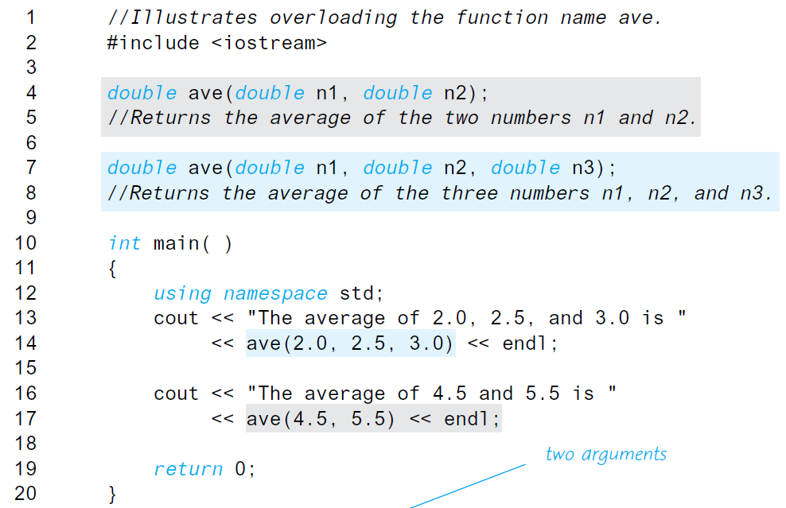
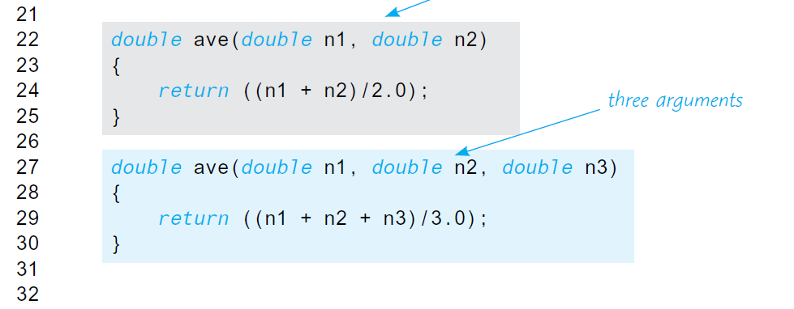
Overloading Functions
Example of Overloading a Function Name

